Slide 1
From Python Code to KNIME node: Share Custom Tools with Non-Coders
Dr. Tuğrul Kaynak, KNIME
11 April 2025, RDKit UGM Boston

Slide 2
A familiar situation…
You're the one person in the team who can script in Python
You write useful functions for molecular processing, analysis, or filtering
Colleagues ask: “Can I use this without knowing how to use Python?”

Slide 3

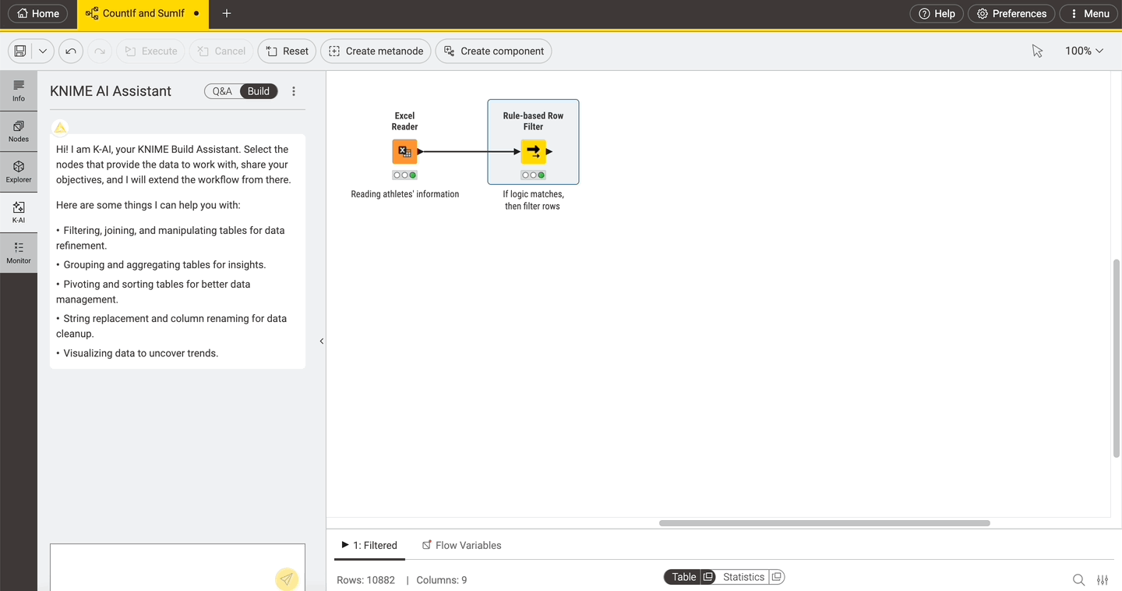
KNIME Analytics Platform
Access, blend, and transform data from any source
Access data from any data source - your laptop, an application or a data warehouse
Easily blend data of any size and any type - all file formats supported
Aggregate, sort, filter, and join data on your device, in-database, or in distributed big data environments
Visualize and analyze
Save, share, and reuse
Upskill
https://www.knime.com/getting-started-guide

Slide 4
KNIME + Python: The Bridge
Coders can use Python where needed
But how to make your code accessible to non-coders?
→ Turn your Python functionalities into KNIME nodes
your teammates can use without writing a line of code!

Slide 5
Types of KNIME + Python Integrations

Slide 6
KNIME Python Integrations: From Low-Code to Pure-Code
Python Script node with Bundled Environment | Python Script node with Custom Environment | Implementing a new KNIME Extension in Python
Code Snippet with commonly used packages | Code Snippet with a special package | Make your Python code available as KNIME nodes
Install KNIME Python Integration | Install KNIME Python Integration + Conda installed and configured in KNIME Preferences | Install your new KNIME extension
What?
Why?
What your users will need:

Slide 7
Pure-Python KNIME node setup
What do you need?
Python code describing the node
Conda environment containing all used Python libraries
knime.yml file describing your extension

Slide 8
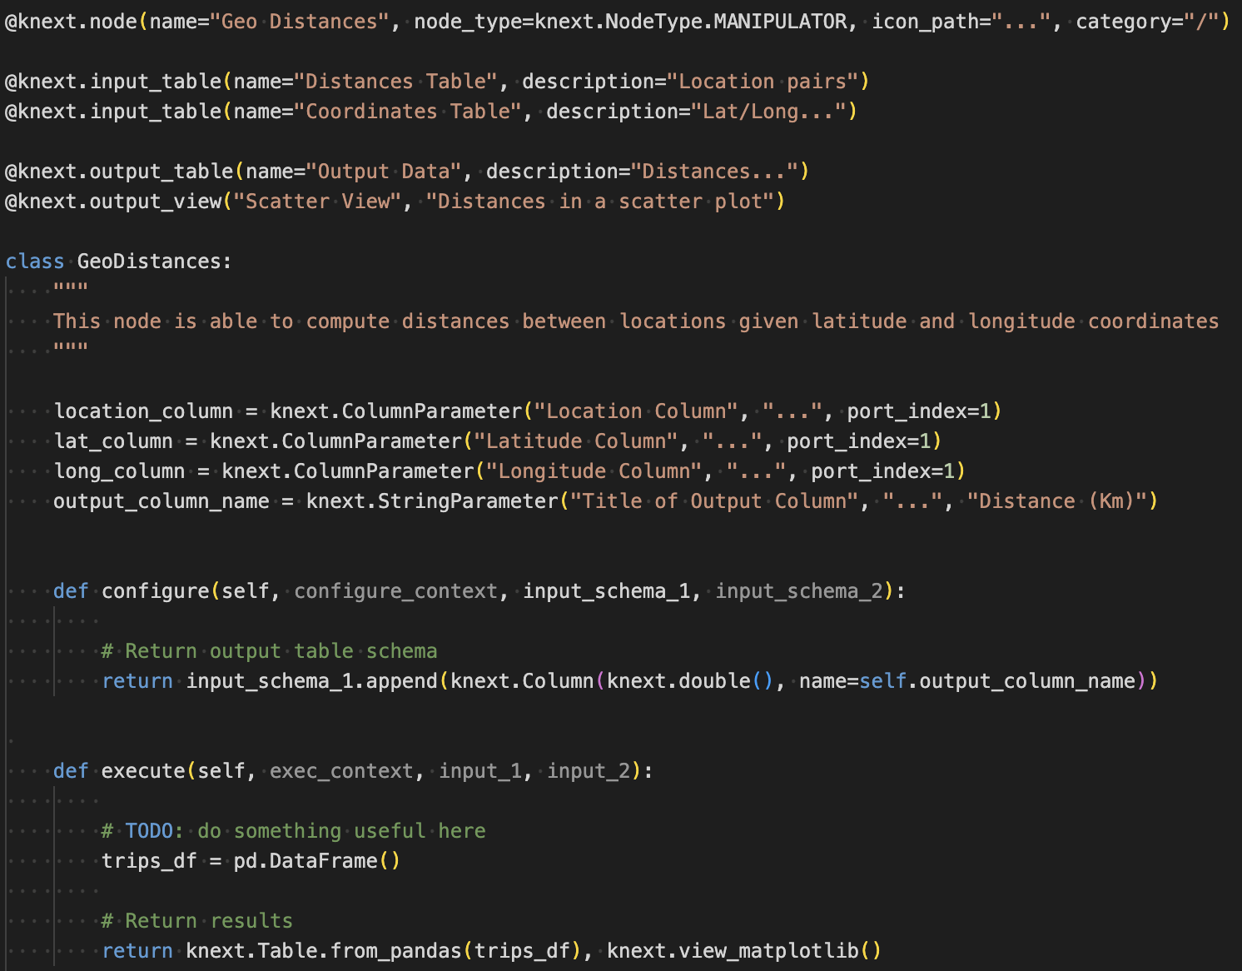
Developing a pure-Python KNIME node
Title of node, category/color, PNG name, location
Input ports with description
Output ports with description
Node class and node description
Parameters for node dialog
“configure” defines input and output table spec
“execute” defines your data analysis
8

Slide 9
How to share

Slide 10
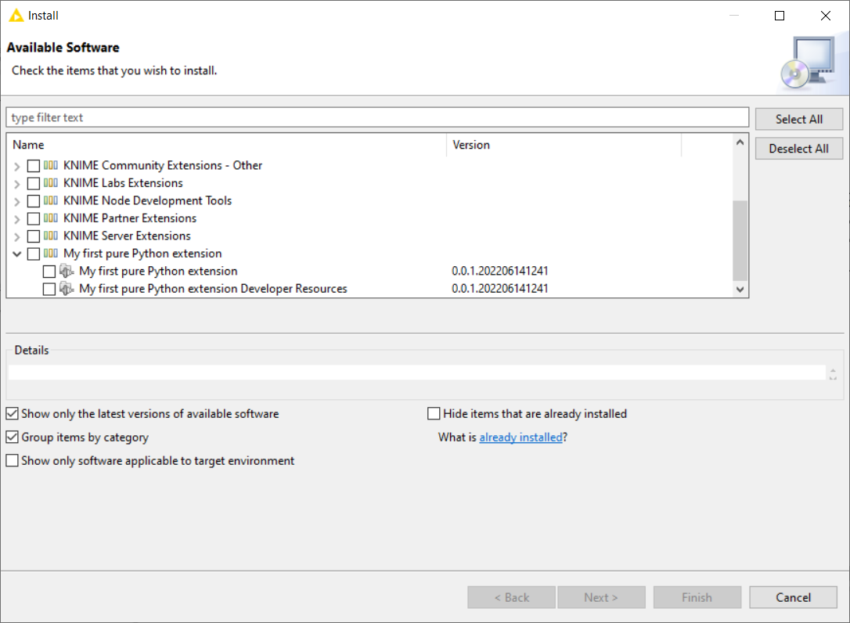
Bundling and Sharing Within An Organization
We provide a command line tool and instructions to turn your Python code into a KNIME extension that can be installed in the KNIME Analytics Platform
Set up a Conda environment for bundling
Build a local update site that can be used by KNIME
Share this update site with colleagues
Let them install your Python-based KNIME extension

Slide 11
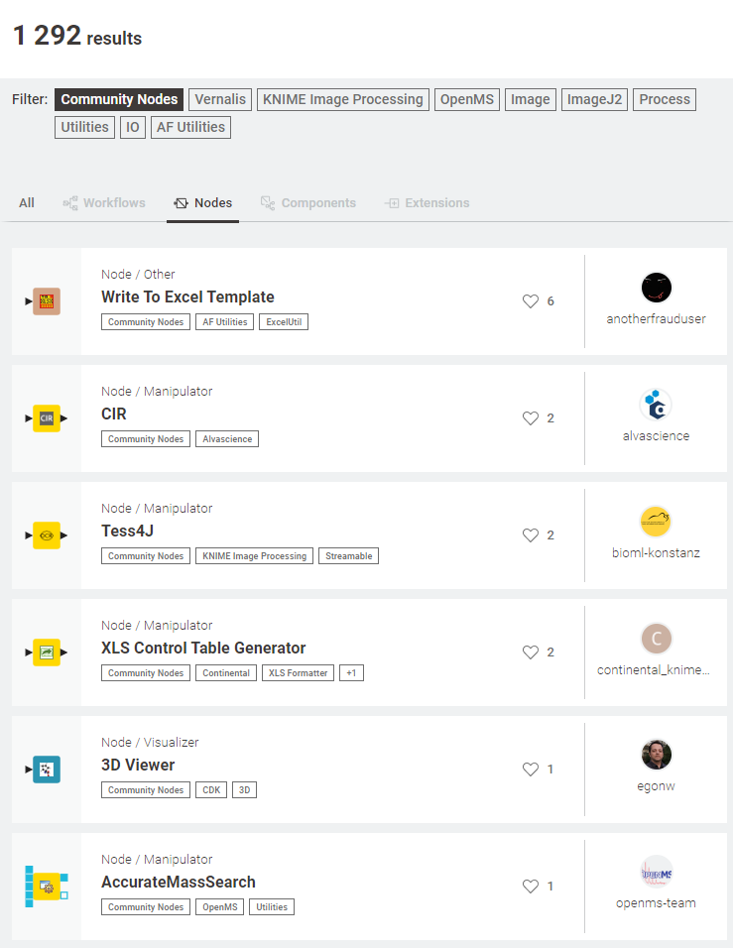
Sharing to the Entire Open-Source Community
Be a contributor!
Share your code in a publicly available Git repository (e.g. BitBucket, GitLab, GitHub)
Send a request to community-contributions@knime.org
We will build the extension for you
Your nodes will go live on: hub.knime.com

Slide 12

knime.com/events

Slide 13

Stay in touch!
Tugrul.Kaynak@knime.com
linkedin.com/in/tugrul-kaynak

Slide 14
Appendix: Material to get started

Slide 15
Software Prerequisites
Code editor, e.g., Visual Studio Code
KNIME Analytics Platform: https://www.knime.com/downloads
Install Extension: KNIME Python Extension Development (Labs)
Conda / Miniconda, set environment up:
conda env create --name lwreg_knime --file=https://raw.githubusercontent.com/rinikerlab/lightweight-registration/main/environment.yml
conda activate lwreg_knime
python -m pip install git+https://github.com/rinikerlab/lightweight-registration
conda install knime-python-base=5.3 knime-extension=5.3 -c knime -c conda-forge

Slide 16
Tutorial Package
Download basic.zip: https://docs.knime.com/latest/pure_python_node_extensions_guide/img/basic.zip
Unzip:
→ Ready for the quickstart tutorial: https://docs.knime.com/latest/pure_python_node_extensions_guide/index.html#tutorial-writing-first-py-node
.
├── tutorial_extension
│ │── icon.png
│ │── knime.yml
│ │── LICENSE.TXT
│ └── my_extension.py
├── config.yml
├── my_conda_env.yml
├── Example_with_Python_node.knwf
└── README.md

Slide 17
Other Material
Example code: KNIME Nodes for Google Ads: https://bitbucket.org/KNIME/knime-python-google-ads/
WIP: LWReg (Riniker Lab) – KNIME integration: https://github.com/rdkit/knime-lwreg
Publishing extensions:
Publish Your Extension on KNIME Community Hub
KNIME’s Open Ecosystem

